Slide 1


Financial Aid & The College Decision Process
Chris George
Director of Financial Aid
University of Denver
Notes:
Good afternoon and welcome, my name is Chris George, the director of financial aid at the University. As a member of CAFAA, the Colorado Association of Financial Aid Administrators, I’m honored to be presenting this information to you today. It appears that we have a packed house for my presentation on Financial Aid and the College Decision Process.

Slide 2

The Admission Office
Determines eligibility for merit based aid
  Evaluate GPA
  ACT and/or SAT Scores
  Extracurricular Activities
  Leadership
  Community Service
  Teacher Recommendations

Slide 3
The Financial Aid Office
Determines eligibility for need-based aid
Establishes the cost of attendance (Sticker Price)
Evaluates family’s ability to pay by determining an expected family contribution (EFC)
Offers financial aid based on the cost of attendance and the expected family contribution
Distributes resources in an equitable manner
Counsels families on financial issues

Slide 4
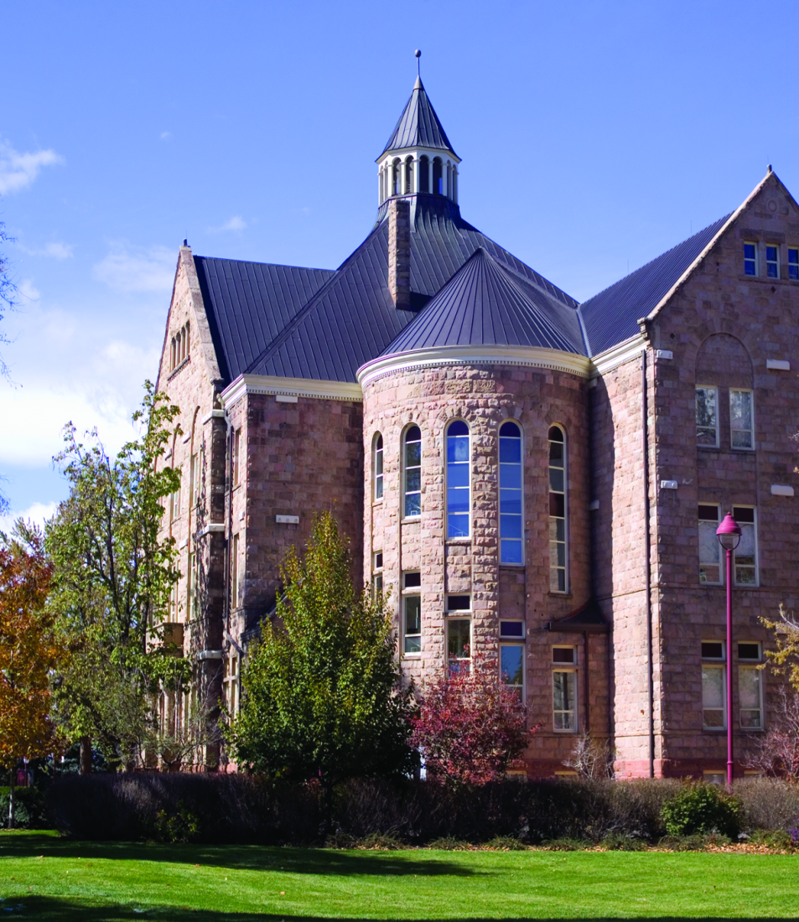
Financial Aid Applications
FAFSA – Free Application for Federal Student Aid
  Required to determine eligibility for many federal, state and institutional aid programs which can include scholarships, grants, work study and student loans
  www.fafsa.gov

Slide 5
Financial Aid Applications
CSS PROFILE – College Board
  Many private universities and scholarship providers require the CSS PROFILE application to determine financial eligibility for institutional aid programs
  Daniels Fund, Colorado College, University of Denver
  profileonline.collegeboard.com
  $25 Application Fee

Slide 6

Financial Aid Applications
FAFSA PIN
  www.pin.ed.gov
  Required
  Serves as a signature
    Student
    Parent
  Instant – email confirmation
  Apply at any time
  If lost, duplicate can be requested

Slide 7
Financial Aid Applications
Documentation needed to complete applications (Parent and Student)
  Federal Income Tax Returns
  W-2 Forms
  Driver’s License
  Social Security Numbers
  Savings and Checking Account Information

Slide 8

Financial Aid Applications
Additional Documentation needed to complete CSS PROFILE application (Parent and Student)
  Records of untaxed income & benefits
  Current Mortgage Information
  Records of stocks, bonds, trusts, and other investments

Slide 9
Financial Aid Applications
Top Tips for Completing Applications
  Meet Deadlines
  You can estimate information on both the FAFSA and CSS PROFILE applications
  Ensure Social Security Number is correct
  Send applications to the correct institutions
  Attend completion events
  Ask questions if you are unsure

Slide 10
Financial Aid Applications
Resources
  Financial Aid Office & Website
    Webinars / Chats / Videos / FAQs
  Application Completion Events
    High School
    College Goal Sunday
    Financial Aid Office
  Department of Education
    @FAFSA
    www.fafsa.gov

Slide 11

Financial Aid Applications
Expected Family Contribution
  What a family should be able to contribute toward the student’s education over a 9 month period of time
Notes:
The amount of money that the family is expected to be able to contribute to the student's education, as determined by the Federal Methodology need analysis formula approved by the U.S. Congress. The EFC includes the parent contribution and the student contribution, and depends on the student's dependency status, family size, number of family members in school, and taxable and nontaxable income and assets.

Slide 12

Financial Aid Applications
Cost of Attendance
  Direct Costs
    Tuition and Fees
    Room & Board
  Indirect Costs
    Books & Supplies
    Transportation
    Personal Expenses

Slide 13
Financial Aid Applications
Financial Need
  Cost of Attendance
  - Expected Family Contribution
  Financial Need
  Need varies based on cost
  Most colleges are unable to meet 100% of financial need with scholarship and grant aid

Slide 14
Types of Aid
Scholarships & Grants
  Need-based, merit-based, or a combination
Federal and State Grants
  For lower income students & familes
  Student Employment
  Students work on campus 10-20 hours a week
  Paid hourly and variable wage rates
  Great way to gain valuable work experience
  Loans

Slide 15

College Opportunity Fund (COF)
Colorado Residents/Schools Only
Apply at any time
Not Financial Aid
Eligibility varies based on school you will be attending
https://cof.college-assist.org/

Slide 16
Private Scholarships
Civic Groups/Organizations (Rotary, Lions, etc…)
Religious Organizations
Corporations (Target, Coca Cola, Ford, etc….)
www.collegeincolorado.org
www.fastweb.com or www.scholarships.com
Facebook App: My College Dollars
High School Counselor
College or University Financial Aid Office Website

Slide 17
Financial Fit
Net price is the sticker price minus all scholarship and grant aid
The sticker price of a college is not always what parents end up paying
All undergraduate institutions are required to offer a net price calculator that provides students an estimate to attend their college

Slide 18

Award Letters
Comparing Financial Aid Offers
  Grants and Scholarships
  Self-help Aid
    Work Study
    Direct Stafford Loans
  Additional Loan Resources
    Parent PLUS or Private Loans
  Multi-year investment and costs
  Tuition increases

Slide 19
Where Do I Go From Here?
Make financial aid part of your college visits
Do a bit of detective work! Do the colleges use financial need in determining their admission decisions? How does the college treat private scholarships?
Net Price Calculators
Research the school’s outside scholarship policy
Inform colleges about special circumstances

Slide 20

Where Do I Go From Here?
Review admissions and financial aid websites
Meet all application deadlines
Investigate and apply for private scholarships
Financial fit is important!
Good luck!

